Slide 1



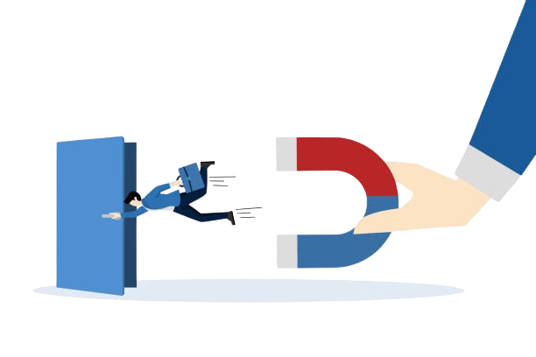
Customer Churn in Telecom Sector
Class:4DS6
16-12-2024

Slide 2






Our Team
Mariam Maammar
Maram Mejri
Chaima Mejri
Houssem Khedher
Firas Bouguerra
Oussema Bargougui

Slide 3

Outline
01
Introduction
05
Modeling
02
Business Understanding
06
Evaluation
03
Data Understanding
07
Retention Strategy
04
Data Preparation
08
Deployment

Slide 4

Introduction
Customer churn prediction is a key business challenge, as retaining customers is often more cost-effective than acquiring new ones.
This project applies the structured CRISP-DM methodology to systematically address the issue, starting from understanding the problem to delivering actionable insights.
By identifying and analyzing the factors that drive customer churn, the project enables businesses to make informed, data-driven decisions aimed at improving customer retention and enhancing overall performance.
4

Slide 5
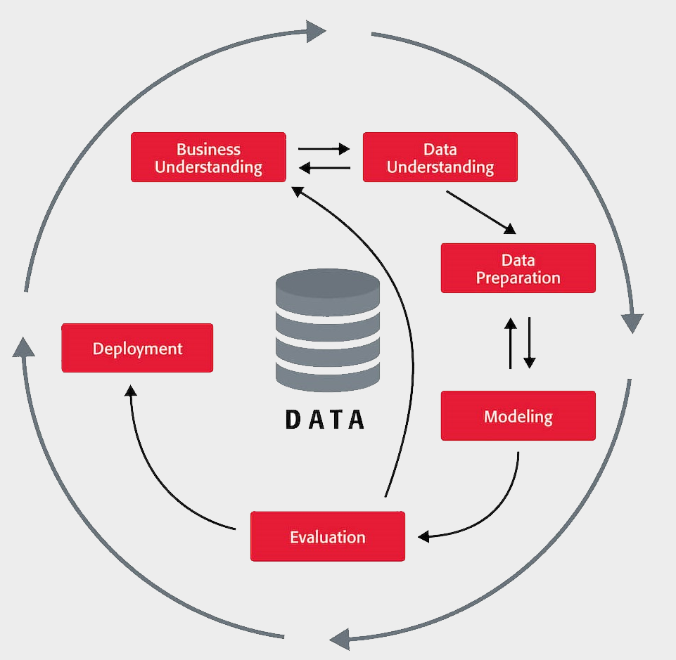
CRISP-DM
5
Notes:
CRISP-DM is a systematic framework that divides the project into six key phases—Business Understanding, Data Understanding, Data Preparation, Modeling, Evaluation, and Deployment—ensuring that each step is thoroughly addressed and directly aligned with the project’s objectives.

Slide 6

Business Understanding

Slide 7
Understanding Customer Churn
Impact on Business
Cost Consideration
Why Predict Churn?
High churn rates can severely affect profitability and growth.
New customer can cost 5–7 times more than retaining an existing one.
Identifies at-risk customers.
Targeted strategies.
Reduces loss & Improves satisfaction.
7
Notes:
Customer churn refers to the phenomenon where customers stop using a company's products or services. It is a critical metric for businesses as high churn rates can significantly impact profitability and growth. Retaining existing customers is often more cost-effective than acquiring new ones, with studies indicating that the cost of acquiring a new customer can be 5–7 times higher than retaining an existing one. Therefore, predicting churn allows companies to identify at-risk customers and implement targeted retention strategies to reduce revenue loss and improve customer satisfaction.Customer churn refers to the phenomenon where customers stop using a company's products or services. It is a critical metric for businesses as high churn rates can significantly impact profitability and growth. Retaining existing customers is often more cost-effective than acquiring new ones, with studies indicating that the cost of acquiring a new customer can be 5–7 times higher than retaining an existing one. Therefore, predicting churn allows companies to identify at-risk customers and implement targeted retention strategies to reduce revenue loss and improve customer satisfaction.

Slide 8
BO & DSO
BO1
Enhance customer satisfaction by Identifying the key factors driving customer churn
BO2
Identify customers with a high likelihood of churn to enable effective retention strategies and minimize churn
8
Notes:
Customer churn refers to the phenomenon where customers stop using a company's products or services. It is a critical metric for businesses as high churn rates can significantly impact profitability and growth. Retaining existing customers is often more cost-effective than acquiring new ones, with studies indicating that the cost of acquiring a new customer can be 5–7 times higher than retaining an existing one. Therefore, predicting churn allows companies to identify at-risk customers and implement targeted retention strategies to reduce revenue loss and improve customer satisfaction.Customer churn refers to the phenomenon where customers stop using a company's products or services. It is a critical metric for businesses as high churn rates can significantly impact profitability and growth. Retaining existing customers is often more cost-effective than acquiring new ones, with studies indicating that the cost of acquiring a new customer can be 5–7 times higher than retaining an existing one. Therefore, predicting churn allows companies to identify at-risk customers and implement targeted retention strategies to reduce revenue loss and improve customer satisfaction.

Slide 9
BO & DSO
DSO1
Build and evaluate advanced machine learning models to determine the best-performing model, analyze key churn-driving features, and design data-driven retention strategies.
DSO2
Build and optimize machine learning algorithms to forecast churn and cluster Costumers to interpret their behavior pattern
9
Notes:
Customer churn refers to the phenomenon where customers stop using a company's products or services. It is a critical metric for businesses as high churn rates can significantly impact profitability and growth. Retaining existing customers is often more cost-effective than acquiring new ones, with studies indicating that the cost of acquiring a new customer can be 5–7 times higher than retaining an existing one. Therefore, predicting churn allows companies to identify at-risk customers and implement targeted retention strategies to reduce revenue loss and improve customer satisfaction.Customer churn refers to the phenomenon where customers stop using a company's products or services. It is a critical metric for businesses as high churn rates can significantly impact profitability and growth. Retaining existing customers is often more cost-effective than acquiring new ones, with studies indicating that the cost of acquiring a new customer can be 5–7 times higher than retaining an existing one. Therefore, predicting churn allows companies to identify at-risk customers and implement targeted retention strategies to reduce revenue loss and improve customer satisfaction.

Slide 10
Data Understanding

Slide 11
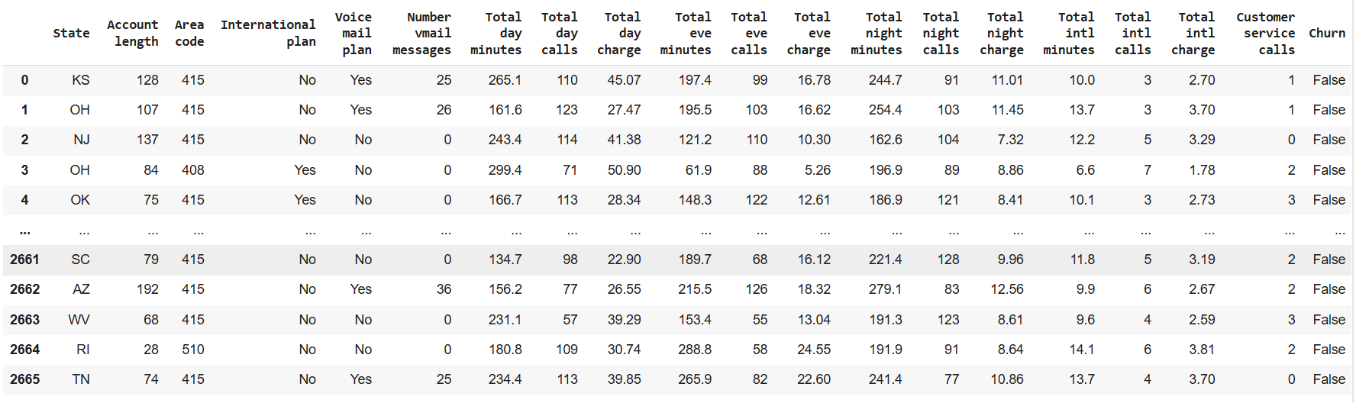
Data Snippet
11
Notes:
Customer churn refers to the phenomenon where customers stop using a company's products or services. It is a critical metric for businesses as high churn rates can significantly impact profitability and growth. Retaining existing customers is often more cost-effective than acquiring new ones, with studies indicating that the cost of acquiring a new customer can be 5–7 times higher than retaining an existing one. Therefore, predicting churn allows companies to identify at-risk customers and implement targeted retention strategies to reduce revenue loss and improve customer satisfaction.Customer churn refers to the phenomenon where customers stop using a company's products or services. It is a critical metric for businesses as high churn rates can significantly impact profitability and growth. Retaining existing customers is often more cost-effective than acquiring new ones, with studies indicating that the cost of acquiring a new customer can be 5–7 times higher than retaining an existing one. Therefore, predicting churn allows companies to identify at-risk customers and implement targeted retention strategies to reduce revenue loss and improve customer satisfaction.

Slide 12
Understanding Variables
Behavioral Variables
These variables represent how customers interact with the telecom services, including their usage patterns and habits
Demographic Variables
These variables reflect customer demographic information that can be used for segmentation and personalization
Service Subscriptions
These variables indicate the services that customers subscribe to, which may influence their satisfaction and likelihood of churn
12
Notes:
Customer churn refers to the phenomenon where customers stop using a company's products or services. It is a critical metric for businesses as high churn rates can significantly impact profitability and growth. Retaining existing customers is often more cost-effective than acquiring new ones, with studies indicating that the cost of acquiring a new customer can be 5–7 times higher than retaining an existing one. Therefore, predicting churn allows companies to identify at-risk customers and implement targeted retention strategies to reduce revenue loss and improve customer satisfaction.Customer churn refers to the phenomenon where customers stop using a company's products or services. It is a critical metric for businesses as high churn rates can significantly impact profitability and growth. Retaining existing customers is often more cost-effective than acquiring new ones, with studies indicating that the cost of acquiring a new customer can be 5–7 times higher than retaining an existing one. Therefore, predicting churn allows companies to identify at-risk customers and implement targeted retention strategies to reduce revenue loss and improve customer satisfaction.

Slide 13
Understanding Variables
Financial Variables
These variables represent the monetary value of the services used by the customer
Complaint Indicators
These variables may reflect dissatisfaction or service issues that could lead to churn
Target Variable
This is the outcome variable you want to predict
13
Notes:
Customer churn refers to the phenomenon where customers stop using a company's products or services. It is a critical metric for businesses as high churn rates can significantly impact profitability and growth. Retaining existing customers is often more cost-effective than acquiring new ones, with studies indicating that the cost of acquiring a new customer can be 5–7 times higher than retaining an existing one. Therefore, predicting churn allows companies to identify at-risk customers and implement targeted retention strategies to reduce revenue loss and improve customer satisfaction.Customer churn refers to the phenomenon where customers stop using a company's products or services. It is a critical metric for businesses as high churn rates can significantly impact profitability and growth. Retaining existing customers is often more cost-effective than acquiring new ones, with studies indicating that the cost of acquiring a new customer can be 5–7 times higher than retaining an existing one. Therefore, predicting churn allows companies to identify at-risk customers and implement targeted retention strategies to reduce revenue loss and improve customer satisfaction.

Slide 14
Data Summary
Data Shape (2666,20)
NaN Values 0
Duplicates 0
14

Slide 15
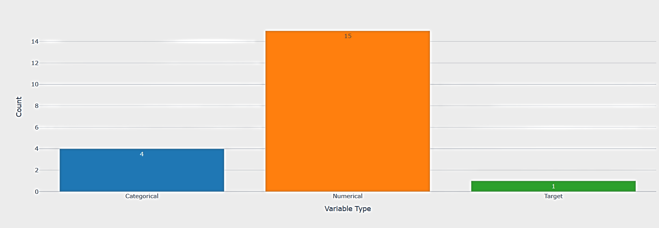
Distribution of Variable Types
15

Slide 16
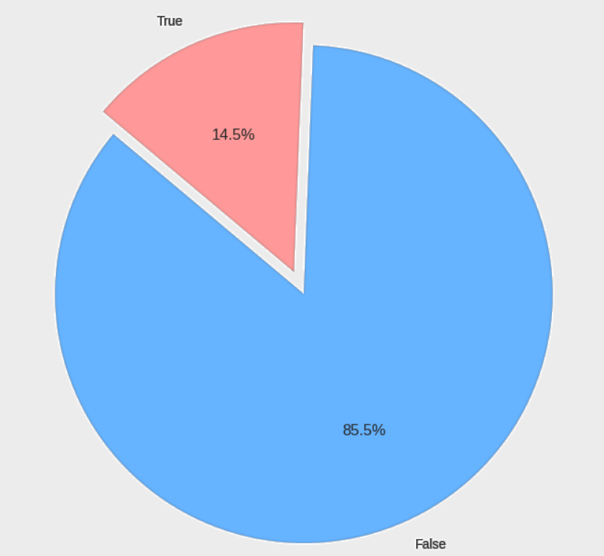
Overall Churn Distribution
14.5%
Churn Rate
85.5%
Non-Churn Rate
16

Slide 17
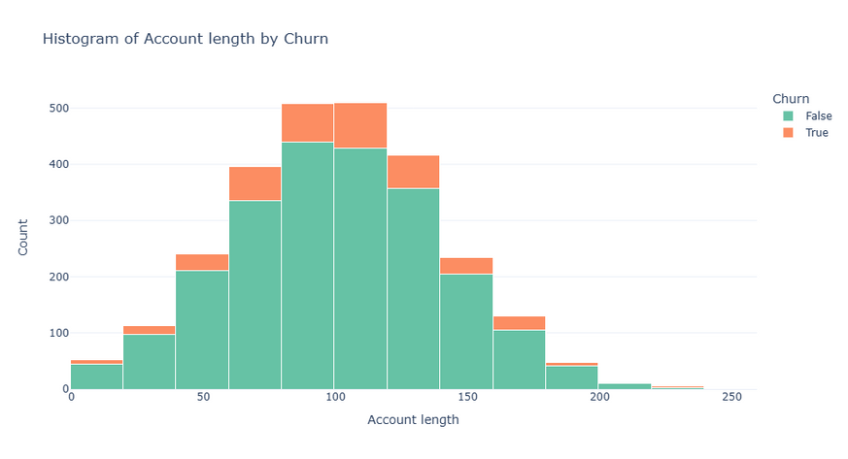
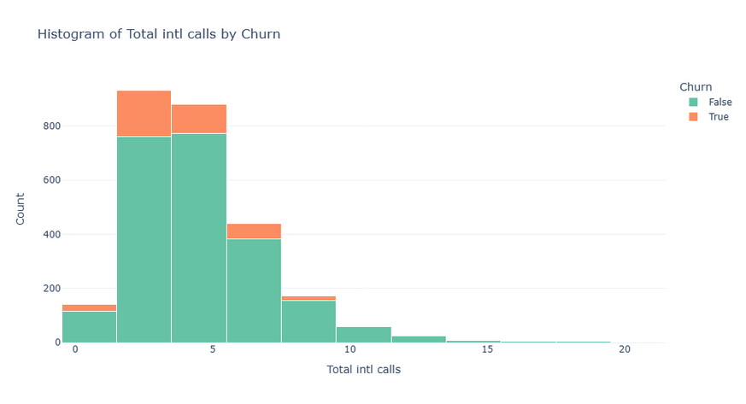
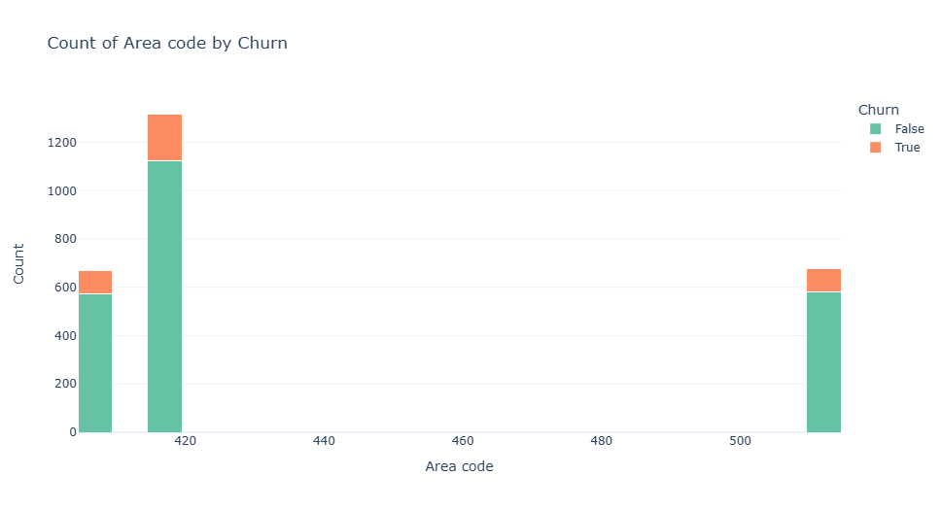
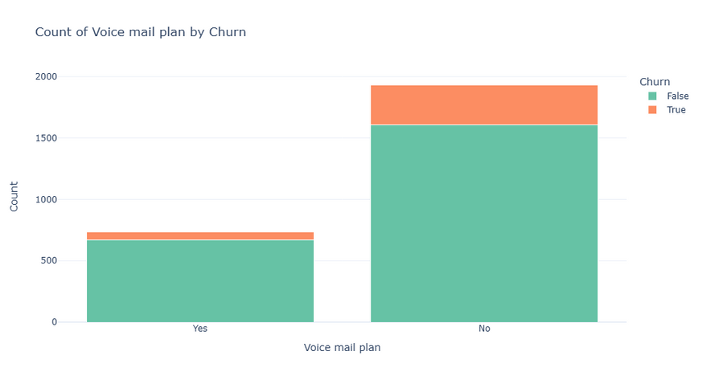
Distribution of Variables by Churn
17

Slide 18
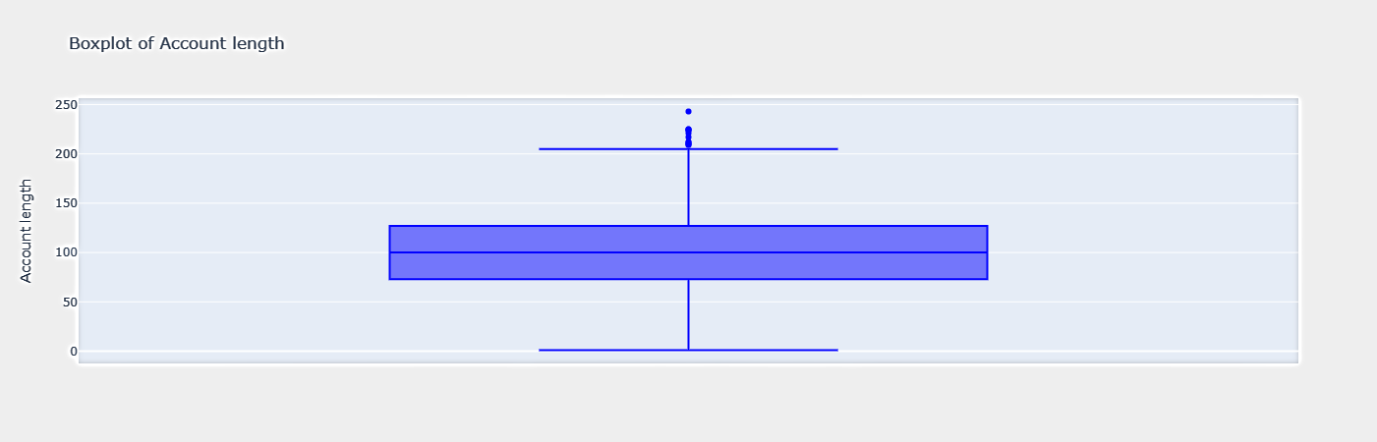
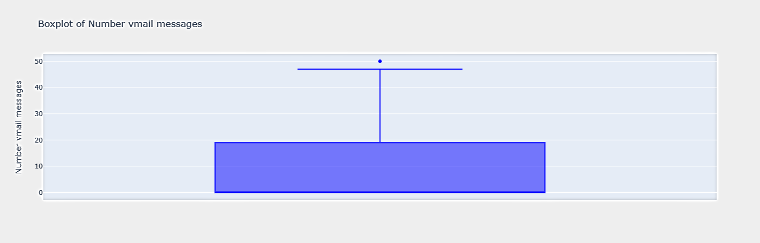
Outlier Detection
18

Slide 19
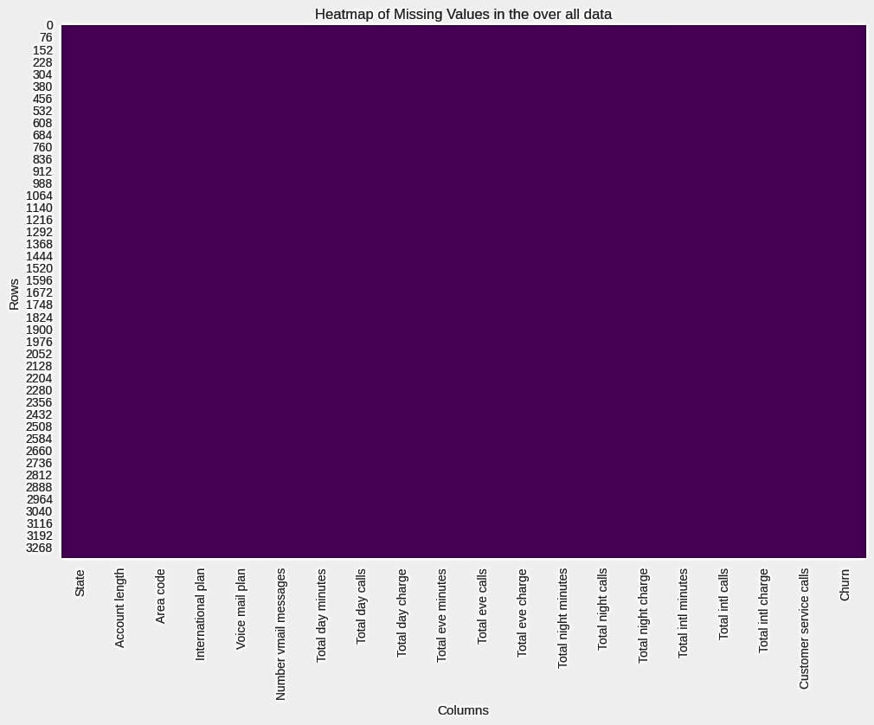
Missing Values
19

Slide 20
Data Preparation

Slide 21

Data Cleaning
Data Quality Assessment
Redundancy 0
NaN Values 0
Outliers no anomalies found
The dataset is clean and ready for analysis.
21

Slide 22

Feature engineering
Total Monthly Charges
Provides a comprehensive view of the customer's monthly spending.
Total Day Charge + Total Eve Charge + Total Night Charge + Total Intl Charge
Purpose
Consolidates the total spending into a single metric.
Simplifies analysis by providing an overall view of customer expenses.
22

Slide 23

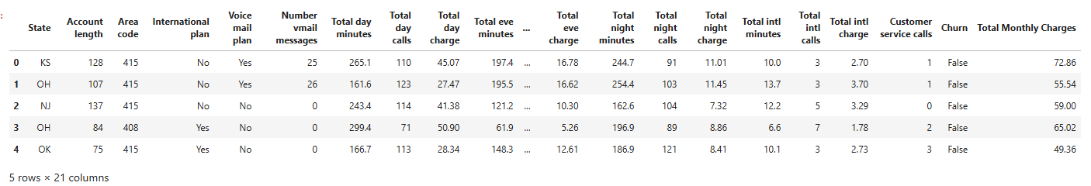

Feature engineering
Outcome
The new feature Total Monthly Charges has been successfully added to the dataset, allowing us to better understand customer spending behavior.
23

Slide 24

Data Transformation
01
Step1: Feature Classification
Account Length:
Categorized into Short-term (1), Mid-term (2), and Long-term (3) based on statistical quantiles.
Customer Service Calls:
Categorized into Few (1), Moderate (2), and Frequent (3) using quantiles.
02
Step2: Area Code Transformation
Encoded the Area Code feature into integers 1, 2, and 3 for simplicity.
24

Slide 25
Data Transformation
03
Step3: State Encoding
Converted the State feature from string labels to numerical values using LabelEncoder.
04
Step4: Binary Encoding
Transformed categorical columns (International Plan, Voice Mail Plan, Churn) into binary values:
Yes → 1, No → 0.
05
Step5: Min-Max Scaling
Scaled all numerical features to a range of [0, 1] to standardize their magnitudes.
25

Slide 26
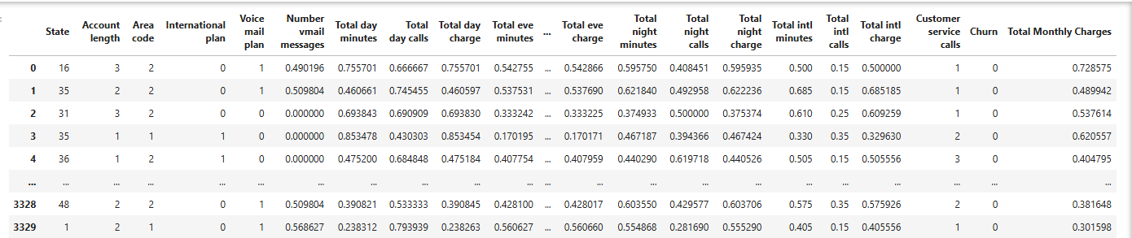
Outcome
26

Slide 27
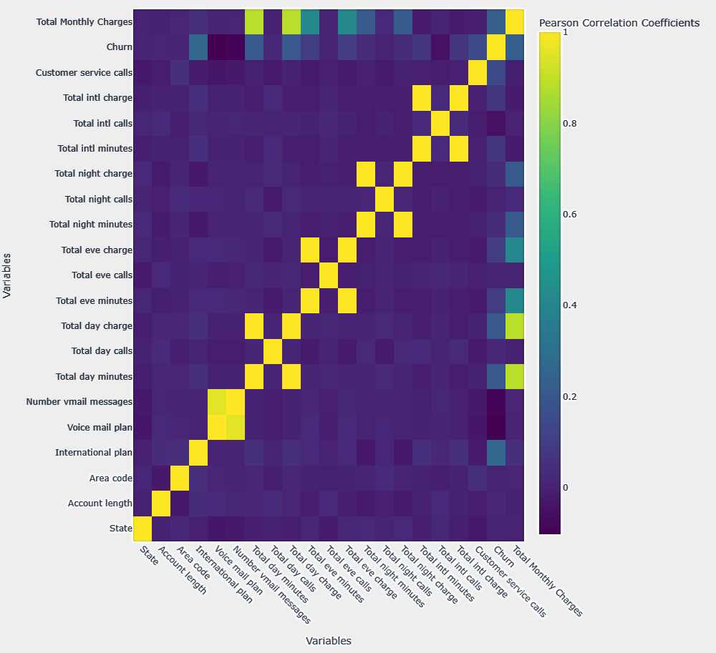
Feature Selection
Correlation Matrix
27

Slide 28
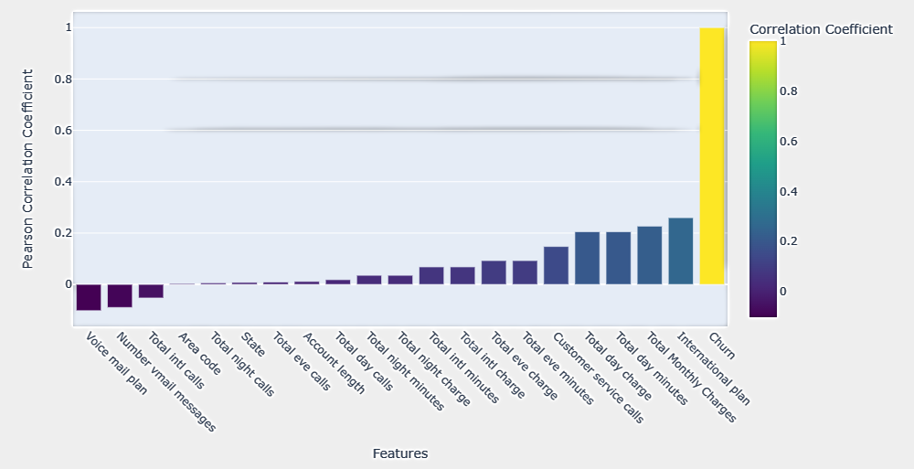
Feature Selection
Correlation of Features with Target
28

Slide 29
Feature Selection
For highly correlated pairs of variables (Pearson correlation ≥ 0.95), we will retain one variable and drop the other based on interpretability and relevance to the model
Keep | Drop
Total day minutes | Total day charge
Total night minutes | Total night charge
Total eve minutes | Total eve charge
Total intl minutes | Total intl charge
Voice mail plan Number | vmail messages
29

Slide 30
Feature Selection
Justification
Minutes vs Charges
Minutes directly represent customer behavior, while Charges are derived metrics.
Retaining minutes will allow for raw and actionable insights without redundancy.
Voice Mail Plan vs Number vmail messages
We will retain it as it provides categorical information, while Number vmail messages is dependent on this variable.
30

Slide 31
Feature Selection
Other Dropped Features
Area code & State
These features are weakly or not correlated with the target variable (Churn) and other predictors.
Including them might introduce noise and reduce model performance.
31

Slide 32


Data Splitting and Balancing with SMOTE & ENN
Data collection
Data analysis
SMOTE
ENN
Purpose: Balances the dataset by generating synthetic samples for the minority class (Churn=1).
How: Creates new samples by interpolating between existing minority samples.
Purpose: Removes noisy or borderline samples after oversampling.
How: Deletes samples that disagree with the majority of their nearest neighbors.
32

Slide 33
Modeling

Slide 34
Build and evaluate advanced machine learning models to determine the best-performing model, analyze key churn-driving features, and design data-driven retention strategies.
DSO 1
34

Slide 35
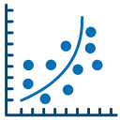

Logistic Regression
Gradient Boosting Machine (GBM)
Role: A straightforward model that predicts the probability of churn based on a linear relationship between features.
Simple and fast to train.
Outputs probabilities that help in setting churn thresholds.
Serves as a starting point to evaluate if churn is linked to basic feature relationships.
Role: A method that improves weak models (e.g., small decision trees) by learning from their errors in steps.
Captures complex patterns in customer behavior.
Performs well even with small datasets or noisy data.
Builds high-accuracy churn prediction models.
35

Slide 36
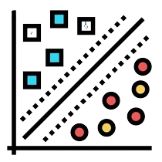
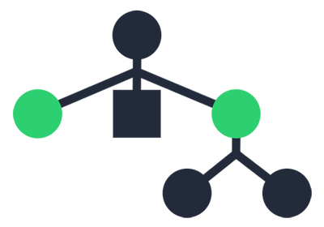
Support Vector Classifier (SVC)
XGBoost Algorithm
Role: Finds the best boundary to separate churners and non-churners in the feature space.
Effective for high-dimensional data (lots of features).
Can handle complex, nonlinear relationships.
Useful when churn data is not well-separated by linear methods.
Role: A faster, more efficient version of Gradient Boosting.
Handles large datasets quickly.
Includes built-in methods for managing missing data and preventing overfitting.
Delivers top performance in churn prediction, especially for datasets with many features.
36

Slide 37
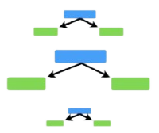
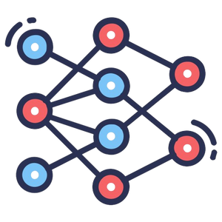
AdaBoost Algorithm
Neural Network
Role: A boosting model that focuses more on customers the previous models struggled to predict.
Increases accuracy by paying extra attention to misclassified churn cases.
Useful for improving performance when churners are a small group in the data.
Role: Detects complex, non-linear patterns in customer data to classify churners and non-churners.
Handles datasets with many features.
Captures relationships and interactions that simpler models may miss.
Best for churn datasets with complex, non-linear relationships and high variability in customer behavior.
37

Slide 38
Build and optimize machine learning algorithms to forecast churn and cluster Costumers to interpret their behavior pattern
DSO 2
38

Slide 39
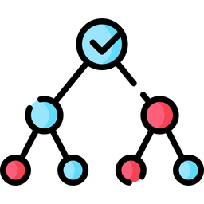
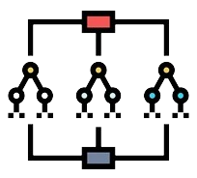
Decision Tree Classifier
Random Forest
Role: A robust ensemble model used for classification.
Handles imbalanced data well by averaging over multiple decision trees.
Identifies key drivers of churn using feature importance.
Provides a reliable baseline and handles noisy data effectively.
Useful for exploring feature significance and creating interpretable models.
Role: An ensemble model that builds multiple decision trees and combines their outputs for better accuracy.
It reduces overfitting by averaging results from many trees.
Identifies which features are most important for predicting churn.
Reliable for handling noisy or imbalanced datasets and providing insights into key churn predictors.
39

Slide 40
Evaluation

Slide 41
Build and evaluate advanced machine learning models to determine the best-performing model, analyze key churn-driving features, and design data-driven retention strategies.
DSO 1
41

Slide 42
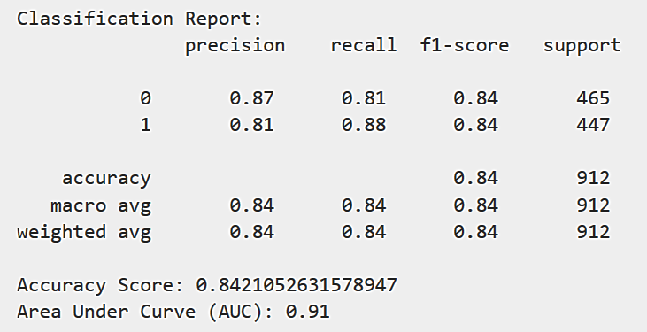
Logistic Regression Algorithm
Classification Report
42

Slide 43
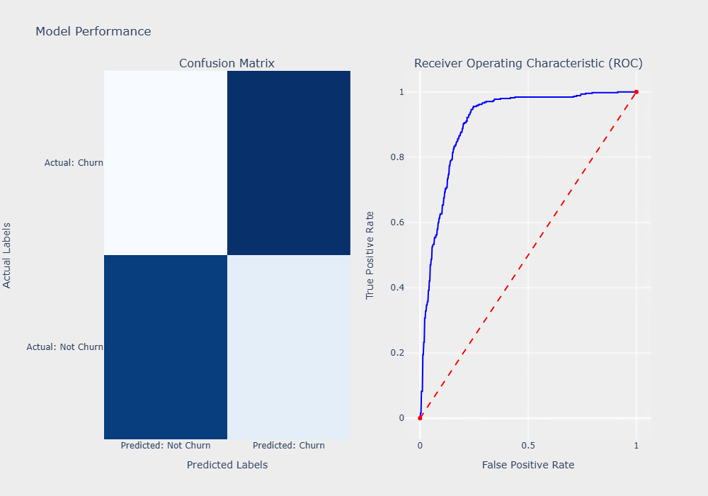
Logistic Regression Algorithm
Model Performance
55
392
376
89
43

Slide 44
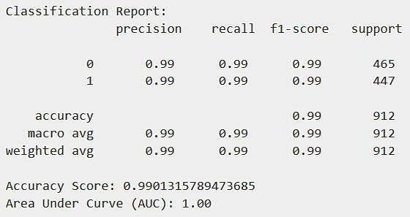
Gradient Boosting Machine (GBM) Algorithm
Classification Report
44

Slide 45
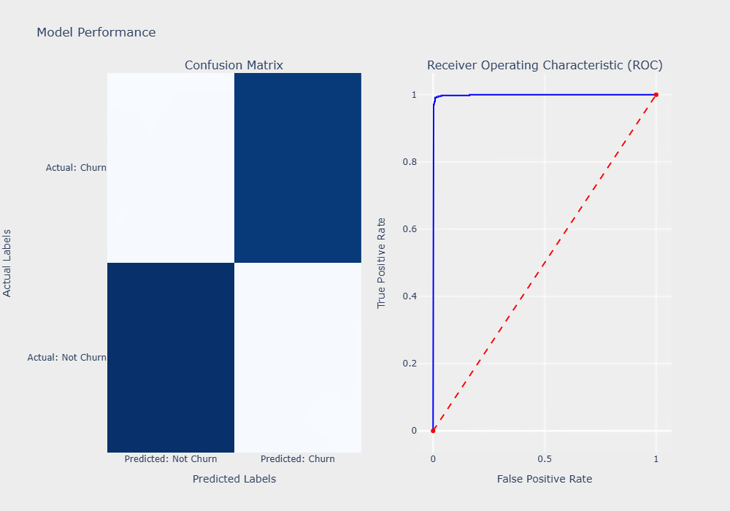
Gradient Boosting Machine (GBM) Algorithm
Model Performance
4
443
460
5
45

Slide 46
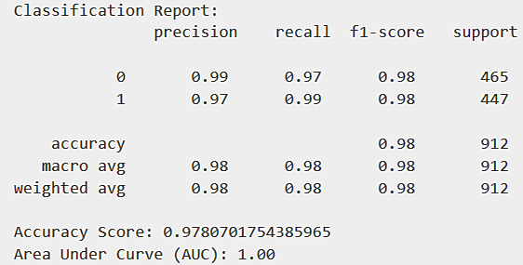
Support Vector Classifier (SVC) Algorithm
Classification Report
46

Slide 47
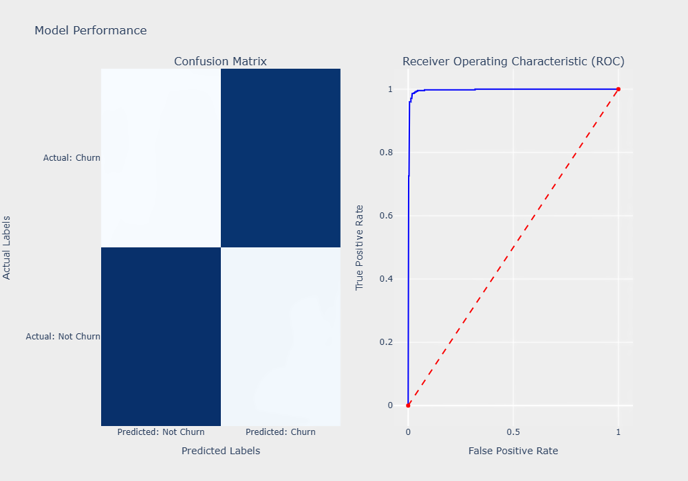
Support Vector Classifier (SVC) Algorithm
Model Performance
4
443
449
16
47

Slide 48
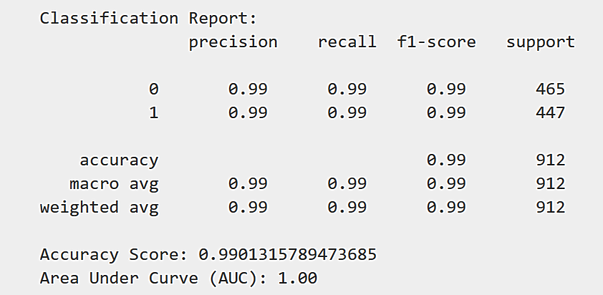
XGBoost Algorithm
Classification Report
48

Slide 49

XGBoost Algorithm
Model Performance
6
441
462
3
49

Slide 50
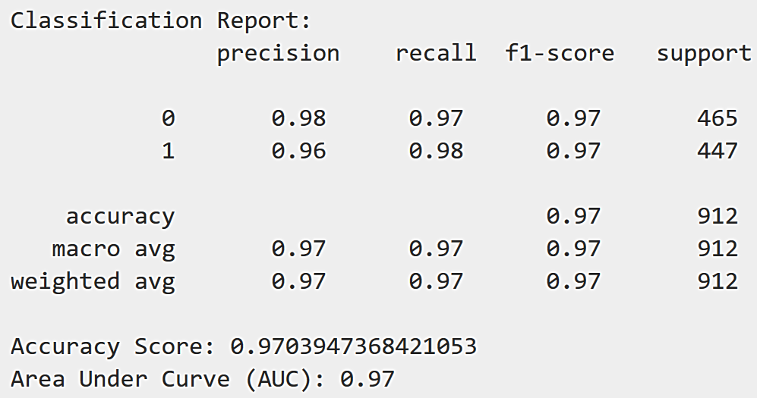
AdaBoost Algorithm
Classification Report
50

Slide 51
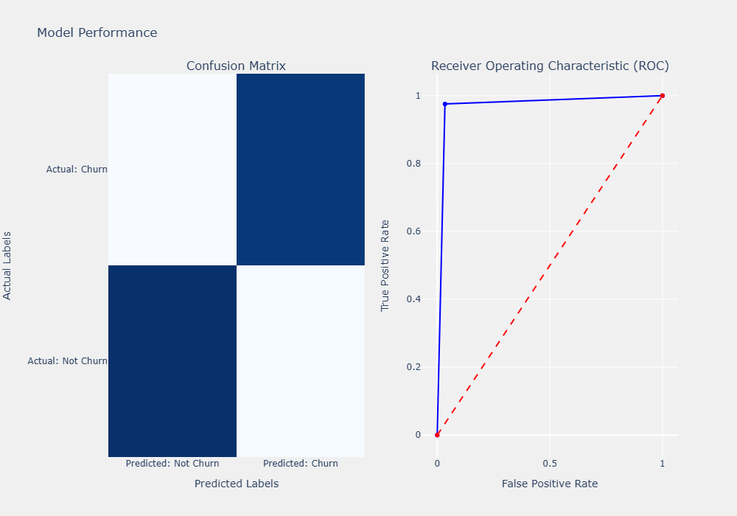
AdaBoost Algorithm
Model Performance
11
436
449
16
51

Slide 52
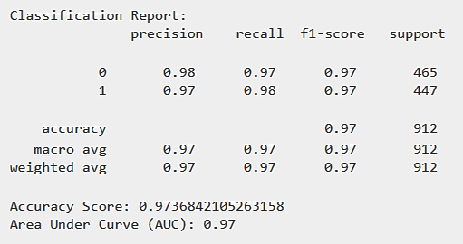
Neural Network
Classification Report
52

Slide 53
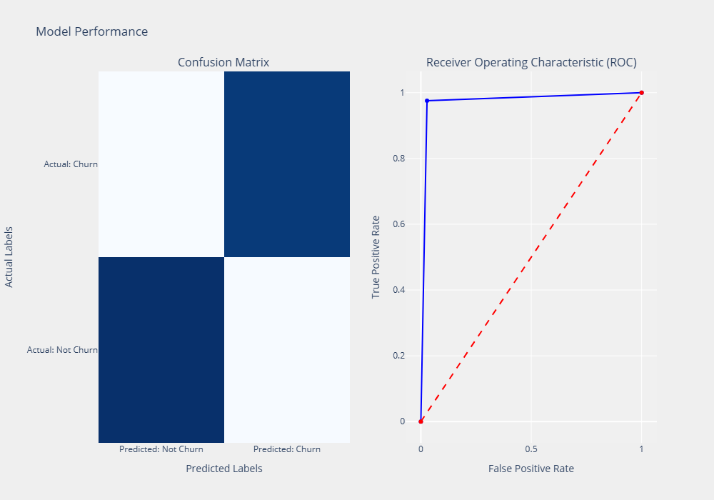
Neural Network
Model Performance
458
7
8
439
53

Slide 54
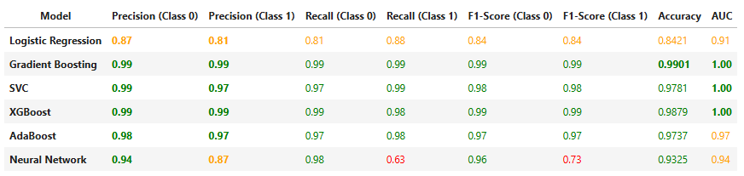
Model Comparison
Top Models: Gradient Boosting (99.01%) and XGBoost (98.79%) lead in accuracy.
Best AUC: Gradient Boosting, XGBoost, and SVC achieve a perfect AUC of 1.00.
Balanced Models: Gradient Boosting and XGBoost perform well across all metrics.
Neural Network: Good accuracy (93.25%) but weak recall for churners (63%).
Logistic Regression: Decent accuracy (84.21%) but lacks precision and recall.
54

Slide 55
Build and optimize machine learning algorithms to forecast churn and cluster Costumers to interpret their behavior pattern
DSO 2
55

Slide 56
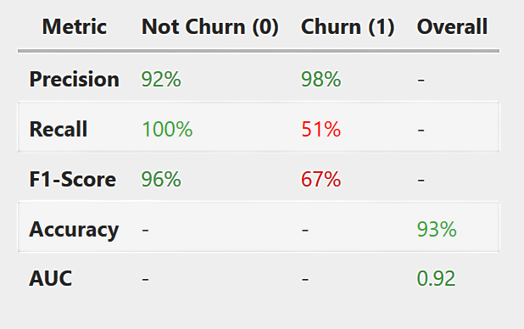
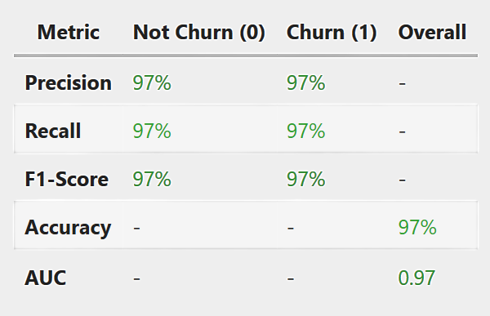
Decision Tree Classifier Algorithm
Classification Report
Before SMOTE & ENN
After SMOTE & ENN
56

Slide 57
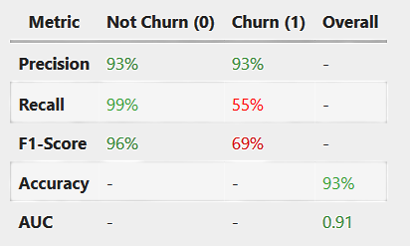
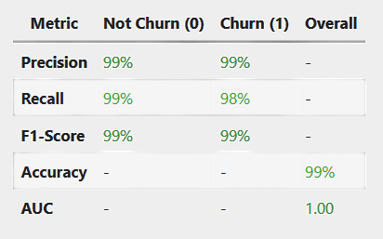
Random Forest Algorithm
After SMOTE & ENN
Classification Report
Before SMOTE & ENN
After SMOTE & ENN
57

Slide 58
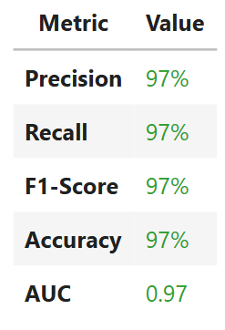
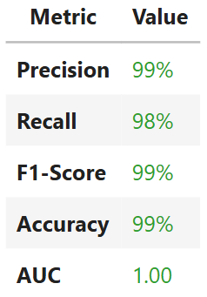
Model Comparison
Decision Tree vs Random Forest Algorithm
Conclusion
The Random Forest Classifier is the better choice for churn prediction due to its higher metrics and robustness.
It is ideal for production-level predictions where performance and reliability are critical.
The Decision Tree Classifier can still be a good option if interpretability is more important (e.g., for explaining decisions to stakeholders).
58

Slide 59
Deployment

Slide 60
Build and evaluate advanced machine learning models to determine the best-performing model, analyze key churn-driving features, and design data-driven retention strategies.
DSO 1
60

Slide 61
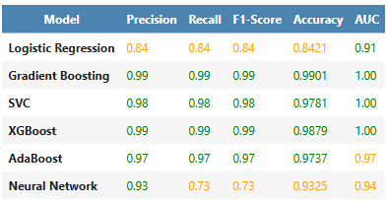
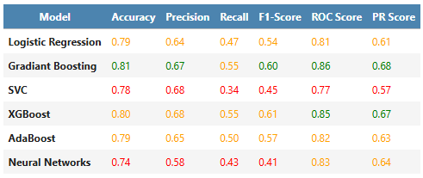
Our Results
Scientific Paper Results
61

Slide 62
Interpretation
Our data is easier to separate and better preprocessed.
The paper's data is harder, with lower Recall and F1-Scores.
XGBoost and Gradient Boosting work well on both.
SVC and Neural Networks struggle with the paper's data.
SMOTE and ENN improve Recall and F1-Scores.
Preprocessing matters more for imbalanced data.
Our data has near-perfect AUC.
The paper’s data has lower AUC due to overlap or noise.
62

Slide 63
Build and optimize machine learning algorithms to forecast churn and cluster Costumers to interpret their behavior pattern
DSO 2
63

Slide 64
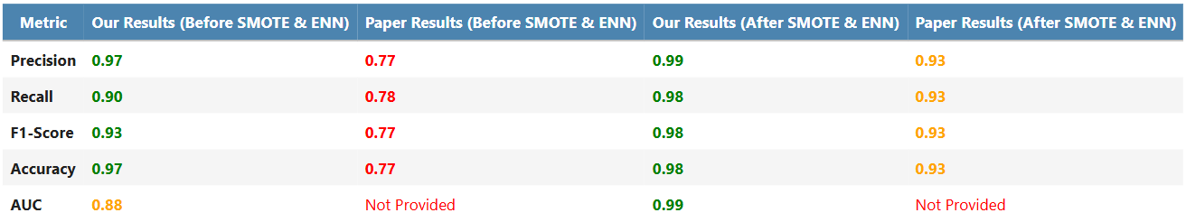
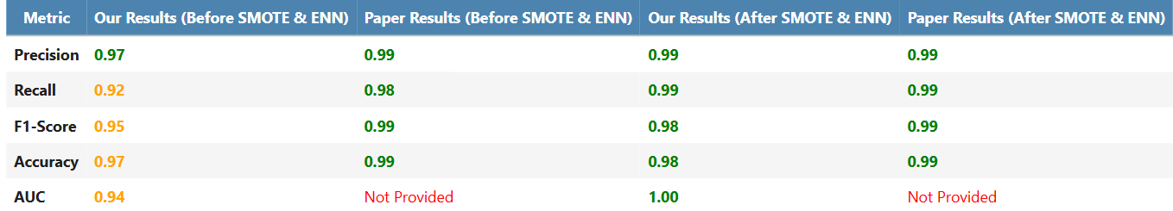
Decision Tree
Random Forest
64

Slide 65
Interpretation
SMOTE and ENN improve results, highlighting the importance of data balancing.
Our dataset outperforms the paper's due to cleaner data and clearer class separability.
Random Forest performs best with SMOTE & ENN.
Decision Tree improves with preprocessing but lags behind Random Forest.
Random Forest achieves AUC = 1.00 in our dataset, showing perfect class separation.
65

Slide 66
Retention Strategy

Slide 67
Build and evaluate advanced machine learning models to determine the best-performing model, analyze key churn-driving features, and design data-driven retention strategies.
DSO 1
67

Slide 68
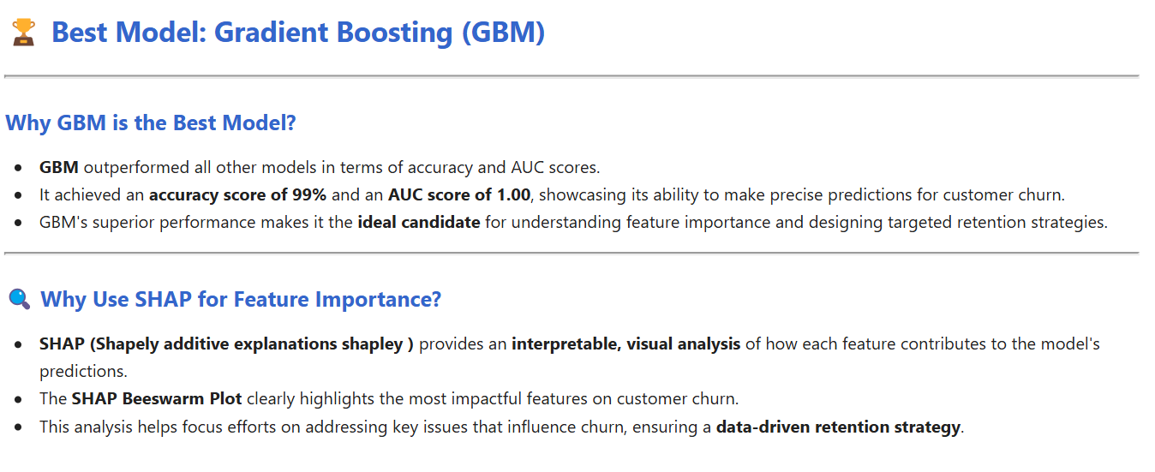
68

Slide 69
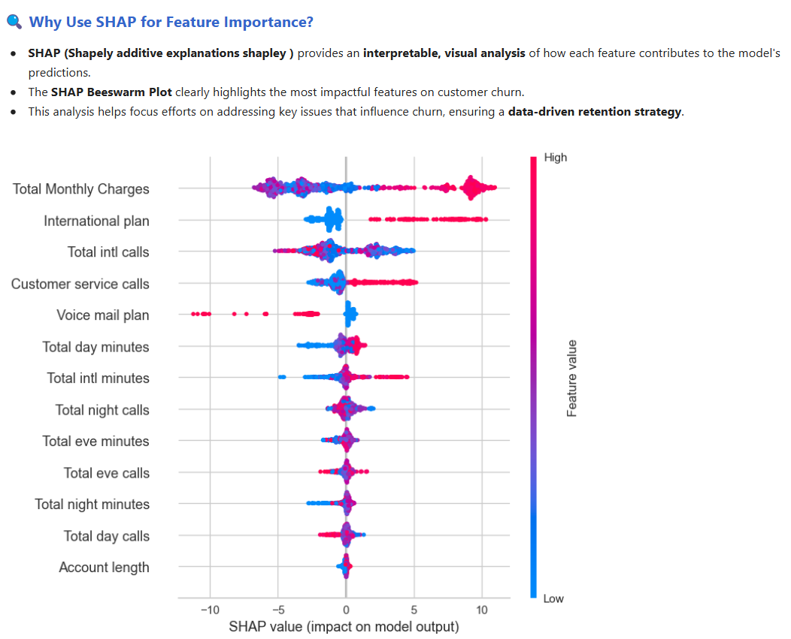
69

Slide 70
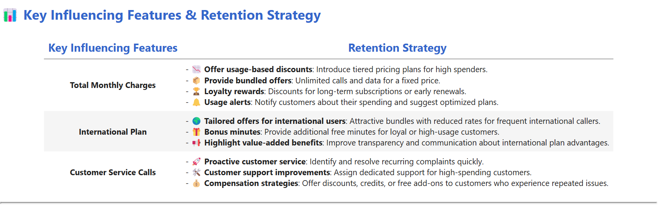
70

Slide 71
Build and optimize machine learning algorithms to forecast churn and cluster Costumers to interpret their behavior pattern
DSO 2
71

Slide 72
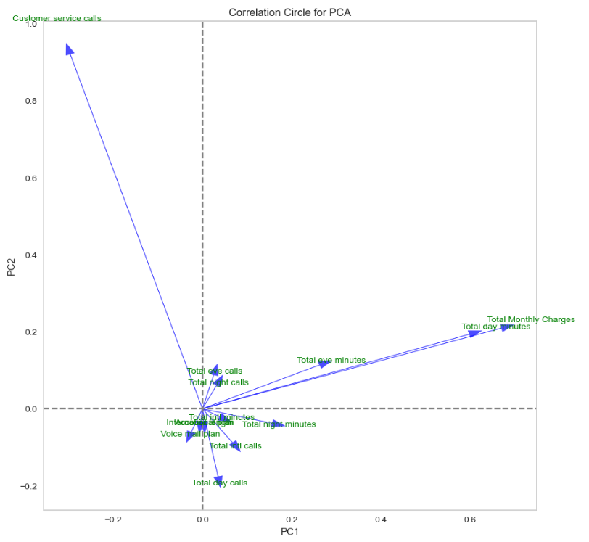
Coreclation cercle for PCA for 2 components that explain the highest variance
72

Slide 73
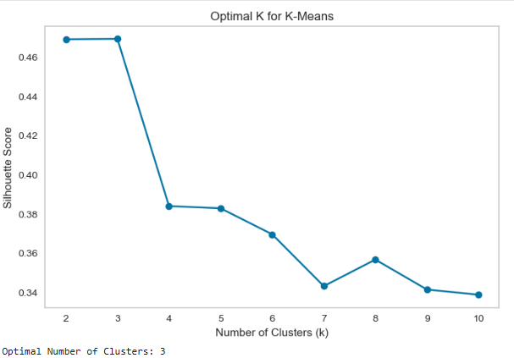
Determine the optimal number of clusters using the silhouette score
73

Slide 74

K-means Clustering
We used PCA to reduce the dimensionality of the dataset to 2 components and applied K-Means Clustering to identify distinct groups of churned customers.
74

Slide 75

75

Slide 76

the table displays mean values of the features for each cluster. It helps interpret how each cluster behaves based on their average feature values.
76

Slide 77

77

Slide 78

Thank You For Your Attention!
78

